Slide 1


Slide 2



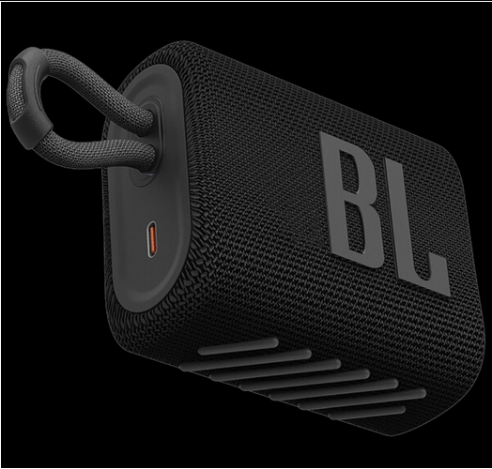
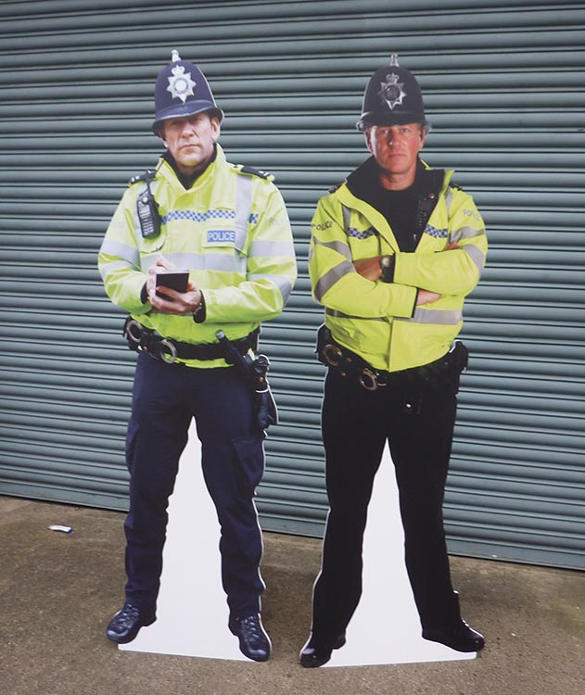

Slide 3
Developing your [ethical] hacker mindset
(or how legitimate hardware/software can be exploited)

Slide 4

Using legitimate tools for ‘hacking’ purposes.
This talk will try to deal with both legitimate and criminal uses of software/hardware, and I’ll try not to bore you with too much grey-area nuance and conspiracy.
Essentially this is a ‘beware of how certain hackers operate, and understand how to protect yourself’ talk. This is not a ‘how to criminal’ talk.

Slide 5
Things you might want to take away from this talk
Understanding how criminals use tools is good when learning how to combat criminal use (think fraud prevention)
Understanding future exploitation of legitimate tools is fun and cool and based (Maybe someone will be phished with the help from a new google API)
Crime bad.

Slide 6
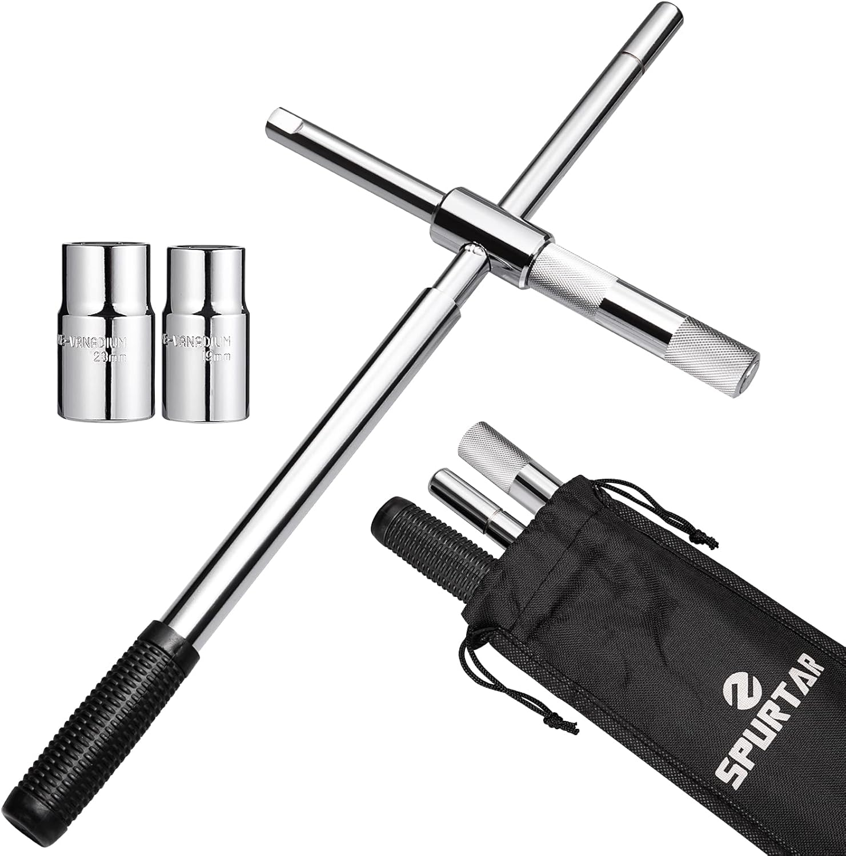
A peek at the legal uses of certain types of hardware
Mechanics and mechanic adjacents have some cool tools in their arsenal

Slide 7
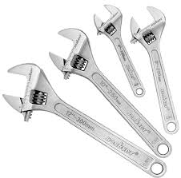
A peek at the legal uses of certain types of hardware
Mechanics and mechanic adjacents have some cool tools in their arsenal

Slide 8

A peek at the legal uses of certain types of hardware
Mechanics and mechanic adjacents have some cool tools in their arsenal

Slide 9
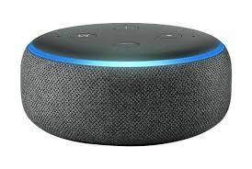
A peek at the legal uses of certain types of hardware
Mechanics and mechanic adjacents have some cool tools in their arsenal

Slide 10
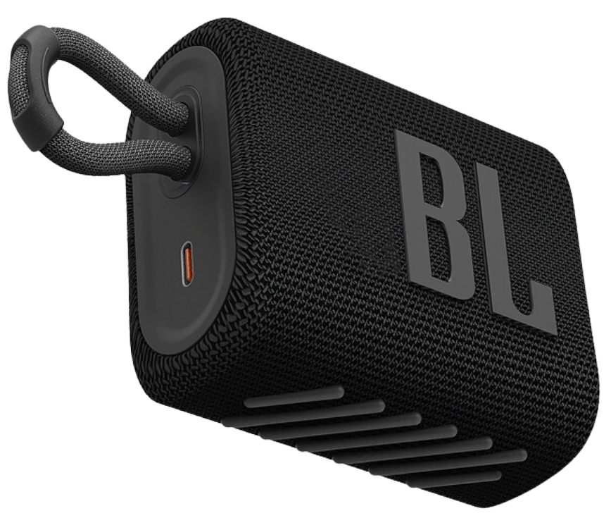
A peek at the legal uses of certain types of hardware
Mechanics and mechanic adjacents have some cool tools in their arsenal

Slide 11
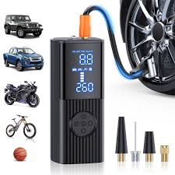
A peek at the legal uses of certain types of hardware
Mechanics and mechanic adjacents have some cool tools in their arsenal

Slide 12

A peek at the legal uses of certain types of hardware
Mechanics and mechanic adjacents have some cool tools in their arsenal

Slide 13
What was the most expensive tool there?

Slide 14


What was the most expensive tool there?

Slide 15
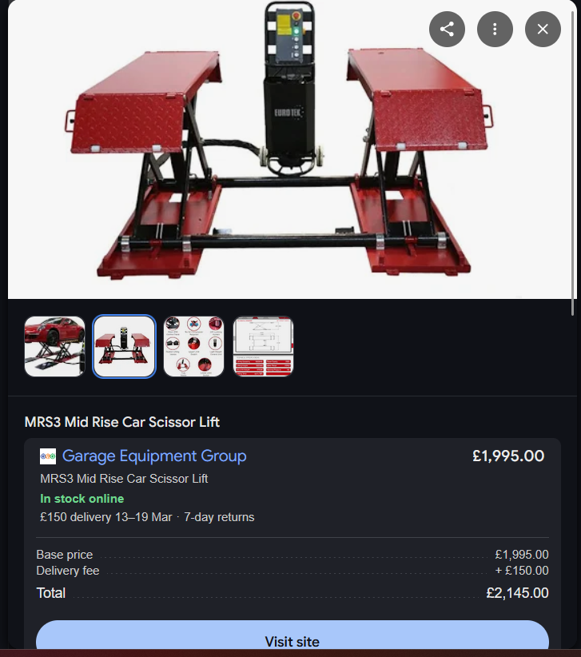

What was the most expensive tool there?

Slide 16
huH???
Anyway that bluetooth speaker wasn’t a speaker.*

Slide 17
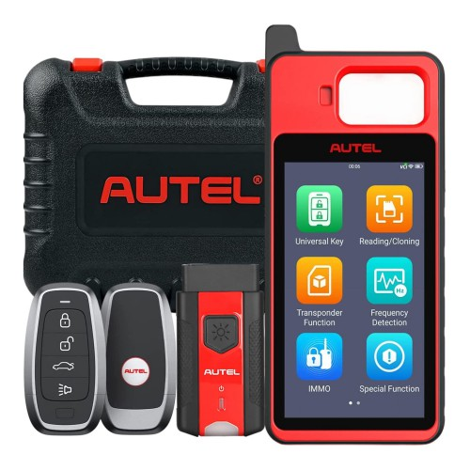
But why???
This intro was going to be nuanced on how legitimate car-key reprogrammers are used to aid in thieves stealing cars.

Slide 18
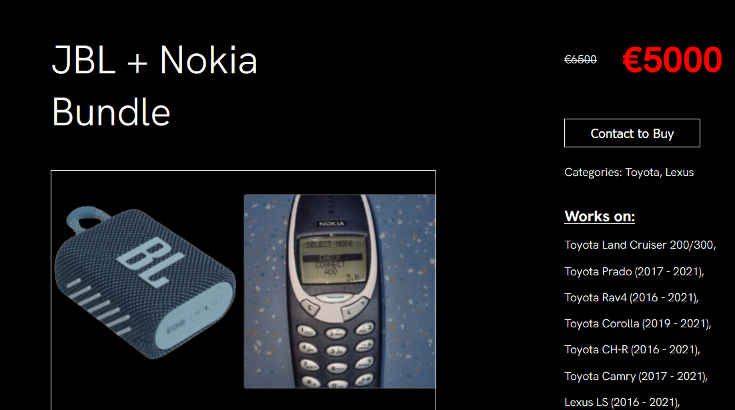
I don’t need to do that though
Instead, thieves can sometimes just buy ‘legitimate’ products that are thinly veiled crime tools.
Like this wacky combo here:

Slide 20

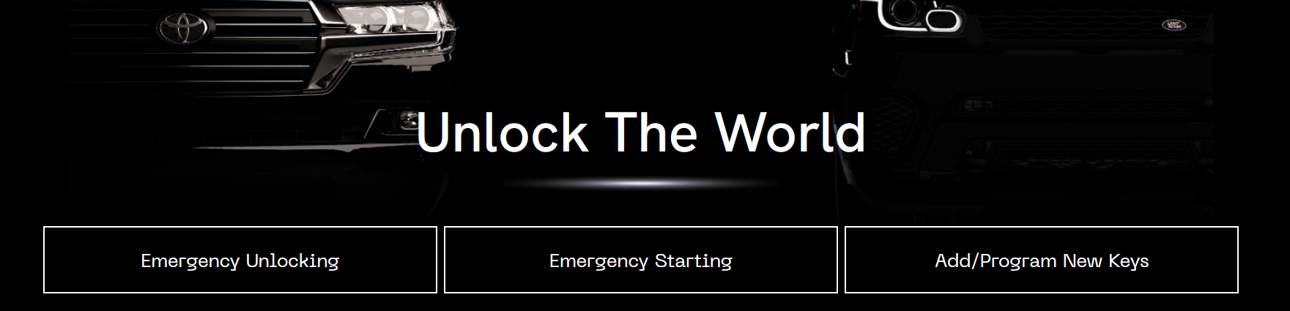
Named an ‘emergency start’ tool.
Legitimately just who needs an emergency start tool for ‘their’ 2021 RAV4 unless it’s sat right here

Slide 21

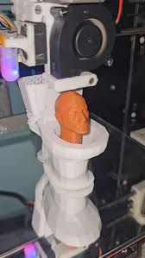


Back to the actual content
Ignoring car thieves and purpose made hacking devices, what actually legitimate hardware can be used in a bad way?
Well, we’ve got:
Surveillance devices
Radio devices
3D Printing devices
Computer peripherals

Slide 22
Hardware quick ones
Surveillance devices are pretty common but why would a bad guy misuse them???????????????????????????????
Here, the legitimate and illegitimate objectives will probably align pretty closely, probably something like:
People tracking
Insight into location security
General info gathering

Slide 23
Hardware quick ones
But yeah anyway, what is to gain with [surveillance] hardware?
Let’s say somehow a hacker has exploited a web-camera being used as site CCTV. (Spoiler CCTV is supposed to be closed circuit for a reason)
Maybe they can see credentials entered into a computer or see / hear interactions between employees. What if they then exploit what they see, either credentials for remote login or interactions to generate sophisticated phishing attack?

Slide 24
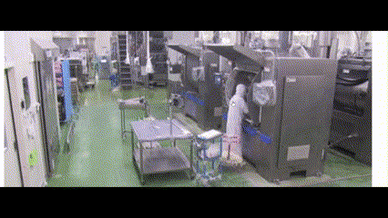
Exposed to the internet for remote monitoring?

Slide 25
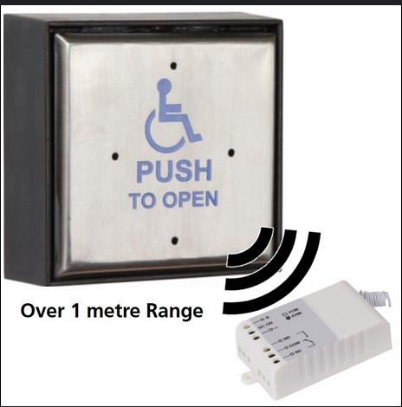
Hardware quick ones
But yeah anyway, what is to gain with [radio] hardware?
Almost the exact same issues, maybe sharing things over the radio-waves that they shouldn’t…
However, there’s also the chance that their infrastructure incorporates radio based accessibility features, such as these:

Slide 26


Hardware quick ones
Sometimes these buttons are tied to the door opener wirelessly by RF, if so it can most likely be targeted via a replay attack. Essentially exploiting the legitimate handicap friendly doors, potentially opening doors they shouldn’t have access to.
[Side note: radio replay attacks can also cause trains to stop in poland, via their legitimate safety function ‘radio-stop’ being exploited.]

Slide 27
Hardware quick ones
But yeah anyway, what is to gain with [3d printing] hardware?
This is wacko so I’m not spending long on it, but data exfiltration again.

Slide 28
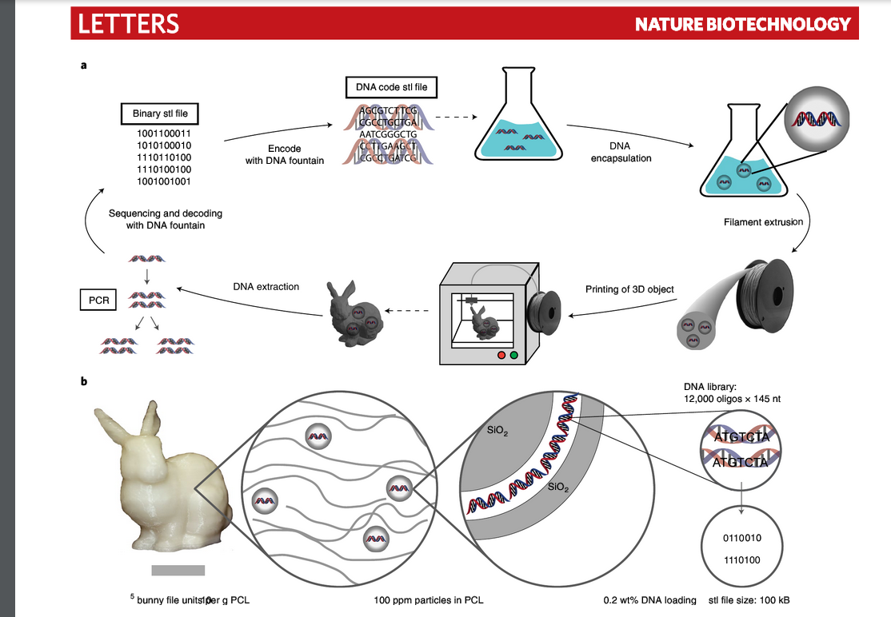
Hardware quick ones

Slide 29


Hardware quick ones
But yeah anyway, what is to gain with [3d printing] hardware?
Or just creating a good old fashioned [freedom device ] to extract data.
Vice journalist? ->

Slide 30
Anyway, hardware summary
So yeah, that yap essentially summarised:
Monitoring hardware can be hacked (and monitored too) by hackers
Consumer radio hardware can be bought easily (for like ~£200)
These can be used to exploit safety and accessibility hardware
Hackers will exploit safety hardware given the chance
3d printing has a wide scope of possibilities.
Such as data exfiltration from a secure location.

Slide 31

The main section: trusted software
The main point of this talk: how trusted and legitimate software or data can be exploited or leveraged by hackers.
Given new software is being released every single day, and data sold, it is important to keep in mind the potential damage which could be caused by abuse.
Average software dev ->

Slide 32
Take, for example, system binaries
Legitimate and necessary software / services running on a system might be abusable, one way or another.
Focusing on linux for brevity, this can take the form of using misconfigured binaries on a system to ‘break out restricted shells, escalate or maintain elevated privileges, transfer files, spawn bind and reverse shells, and facilitate the other post-exploitation tasks’. [gtfobins]
Which is basically me saying hackers (once on a system) can use stuff installed on a system to upgrade a foothold or persist(stay put).

Slide 33
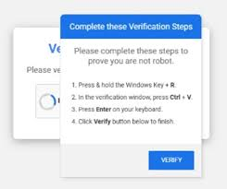
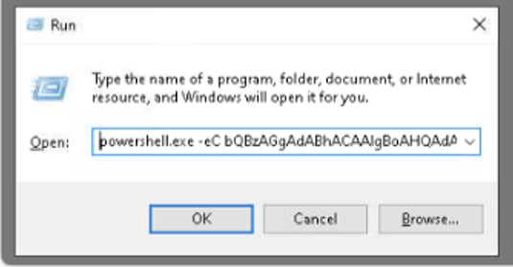
‘Run’ dialogue
Recently, a pretty over-reported malware component involves ‘fake captchas’ which abuse trust, powershell and user permissions to install malware onto a system.

Slide 34
But that’s not what I want to focus on with this talk
This yap fest is focusing more on how ‘hackers’ might abuse, exploit or scam in ways that take advantage of systems that are setup to perform a legitimate service. (yes, powershell is but this is my talk I make the rules, you’ll see what I mean)
Blah blah: let’s look at how hackers can use (web) services in funky ways the developers didn’t intend.

Slide 35
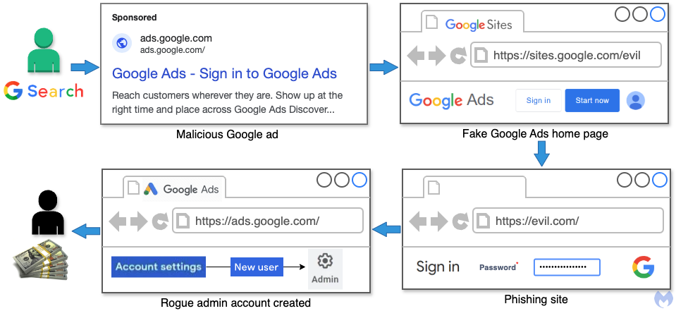
Google Ad services
Have you ever seen google ads? Of course you have. Scammers love them!
Ads on google are especially abused given users trust in the links daddy google feeds them. Yummy slop!!

Slide 36
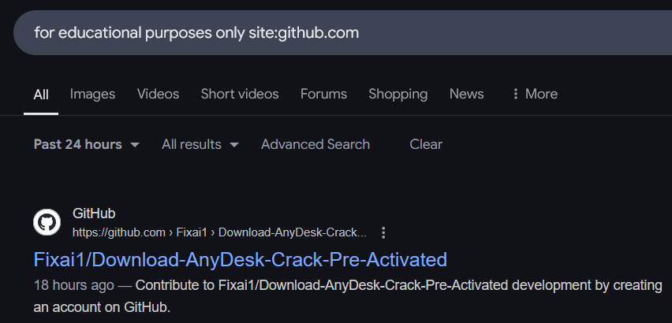
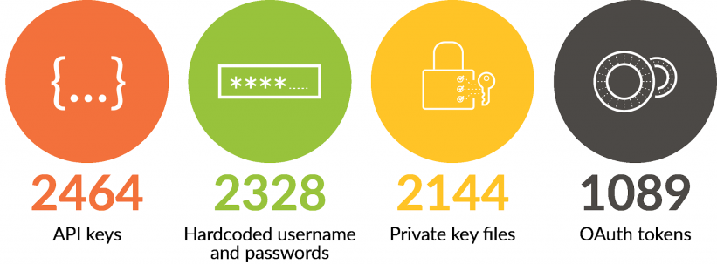
Github
AkA ‘free API keys’ or ‘malware hosting service’, poor github gets misused a lot.

Slide 37
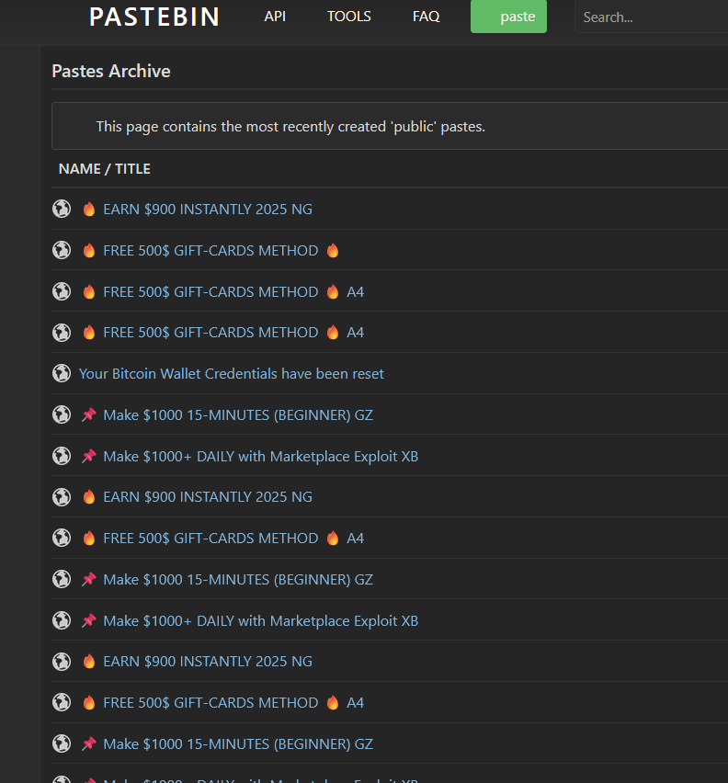
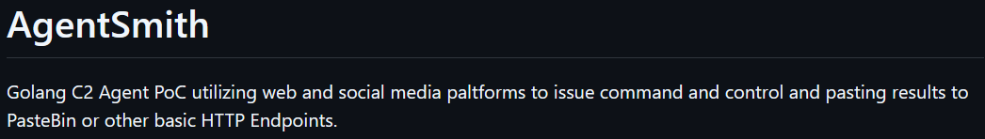
Paste sites, and social media
Paste sites, blog posts, social media… Anywhere that allows text input can and probably will be abused, whether for malware related purposes or just internet spam.

Slide 38
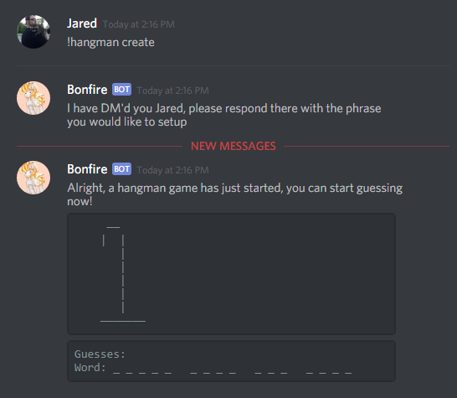
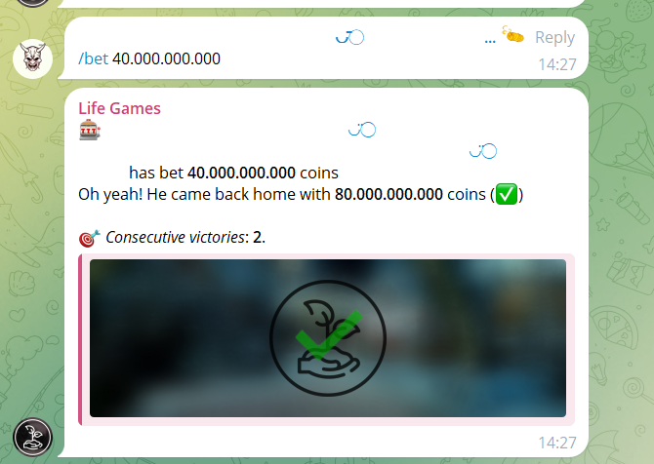
Discord / Telegram bots
Bots, where they would otherwise moderate a community or foster fun interactions:

Slide 39
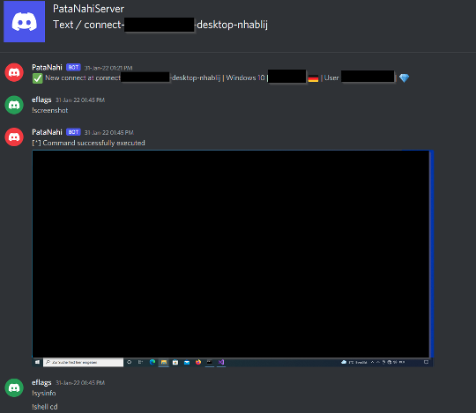
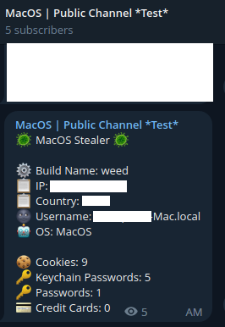
Discord / Telegram bots
Instead just act in funky ways, such as becoming an intermediary for a botnet or showing infected computer files:

Slide 40
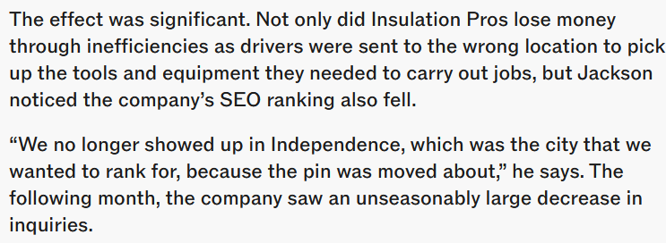
Google maps manipulation
Bad actors can also ruin a businesses search ranking on google through a few methods. Maybe bad reviews, or giving false information on the business.

Slide 41
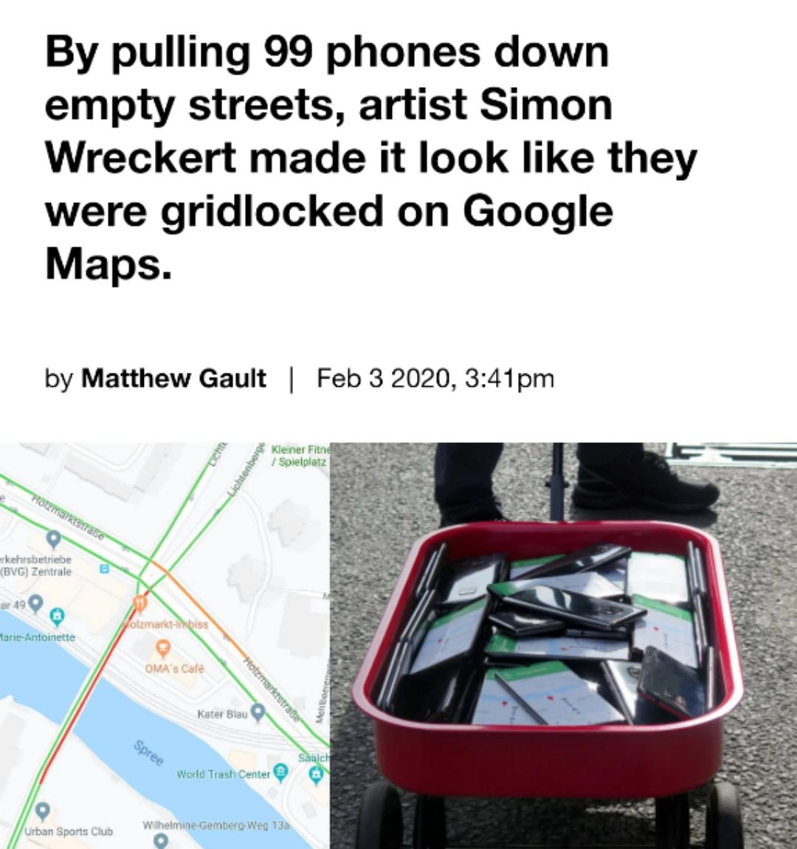
Google maps manipulation
There’s also ‘the funny’

Slide 42
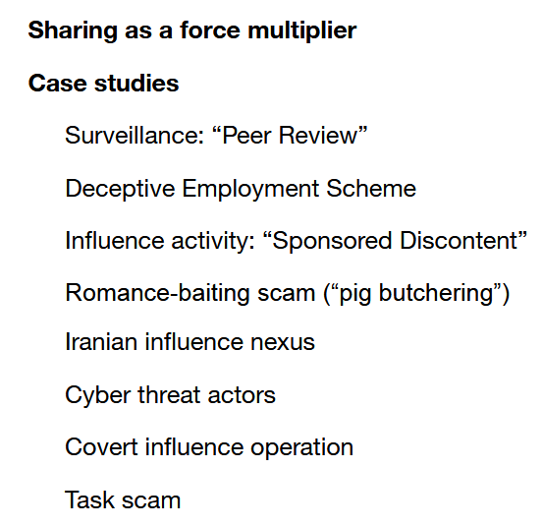
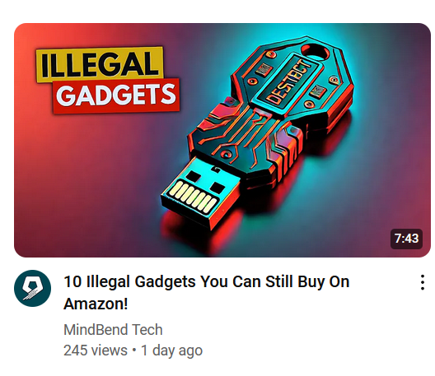
Ai Slop services
LLMs are plentiful and now, so too is Ai generated slop.
Notable mis-usings of Ai LLMs:
Asking it politely for vulnerable device IPs
Asking it for default device passwords
Disinformation campaigns
Creating useless blog posts with misinformation
Scams (see above)

Slide 43
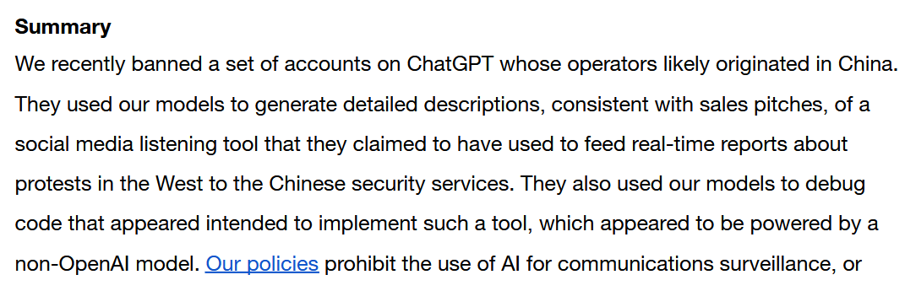
Ai Slop services

Slide 44
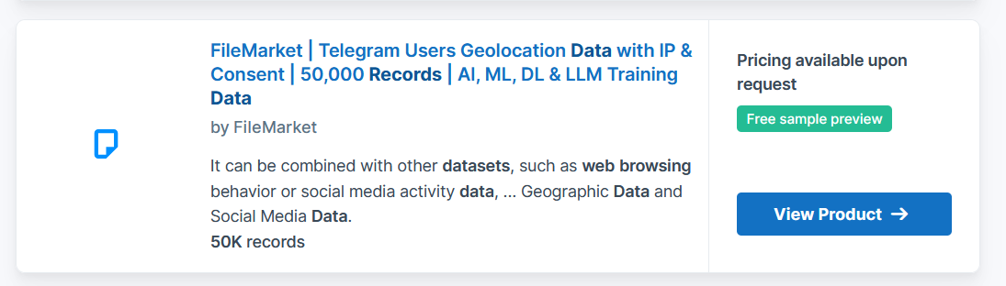
Straight up purchasing data (honorable mention)
I think this speaks for itself in terms of avenues for abuse. so good even the NSA partakes!

Slide 45
TLDR:
Don’t upload passwords to file sharing sites (crawlers are running 24/7)
Don’t expose your security cameras to the internet (crawlers are running 24/7)
Don't believe anything you see online
Don’t get hacked

Slide 46


Your turn!
Find a free Ai tool online (that doesn’t require login)
Do any of the below
Use it to create a ‘phishing page’
Use it to create a ‘scam script’
Use it to create an ‘api / secrets’ scanner for github (or pastebin)
Do not abuse these created items.
Funniest result wins

